Slide 1

Evaluating the Effect of Uncertainty in Pressure Boundary Condition on Patient-Specific Modeling of Coronary Hemodynamics
Presented by:
Mr. Nishanth Panda
(Redg. No.: 2111100377)
Semester: 8th
Under the Guidance of
Dr. Ranjan Kumar Pradhan
(Associate Prof. & Head, Department of Biotechnology)
DEPARTMENT OF BIOTECHNOLOGY
ODISHA UNIVERSITY OF TECHNOLOGY AND RESEARCH
(Formerly College of Engineering & Technology, Bhubaneswar)
Techno Campus, Mahalaxmi Vihar, Ghatikia, Bhubaneswar-751003 Odisha, India

Slide 2
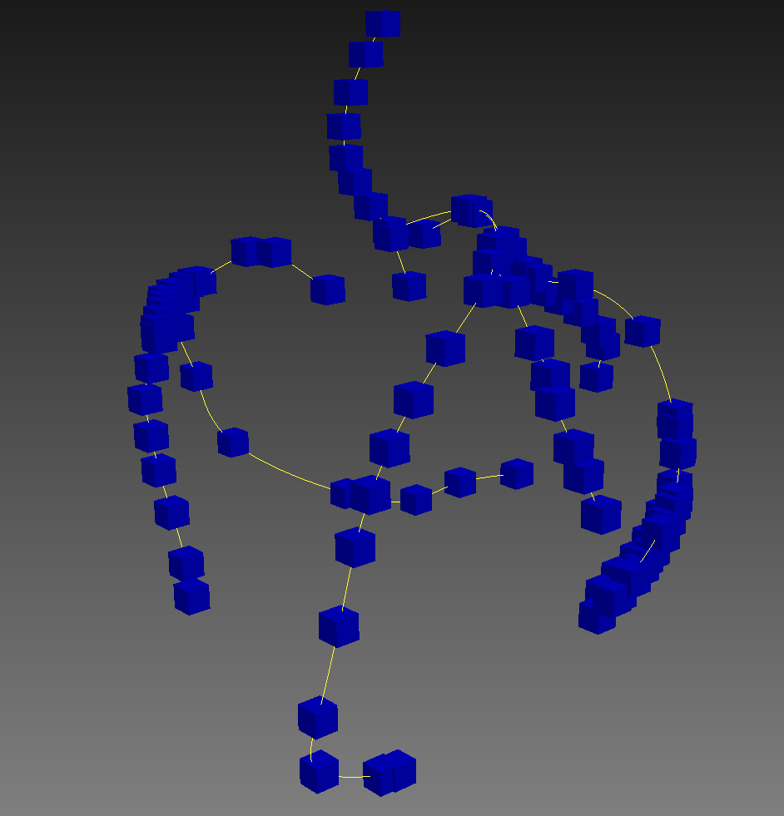
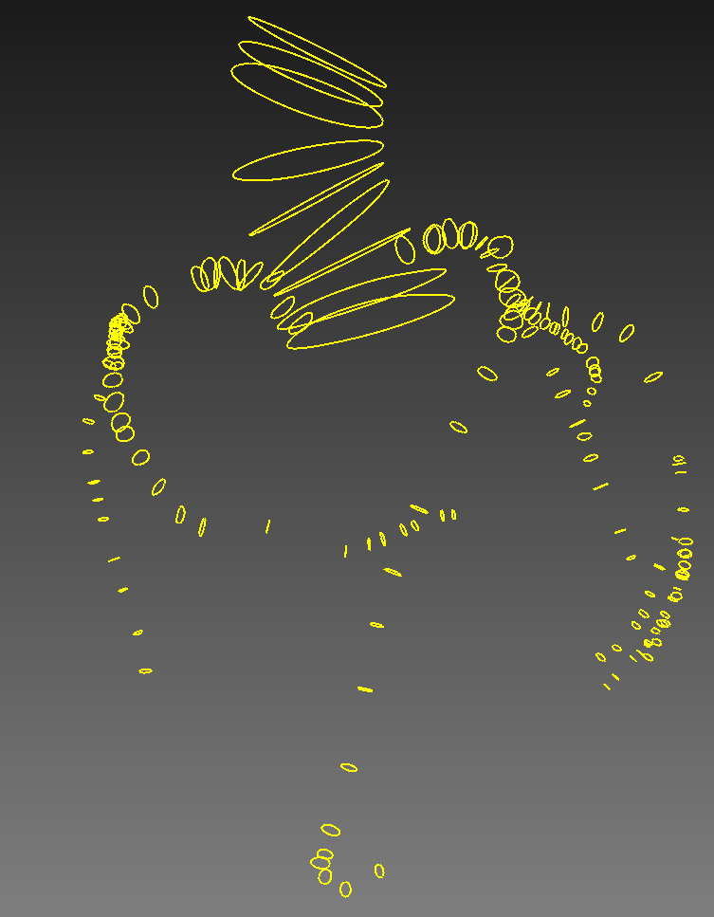
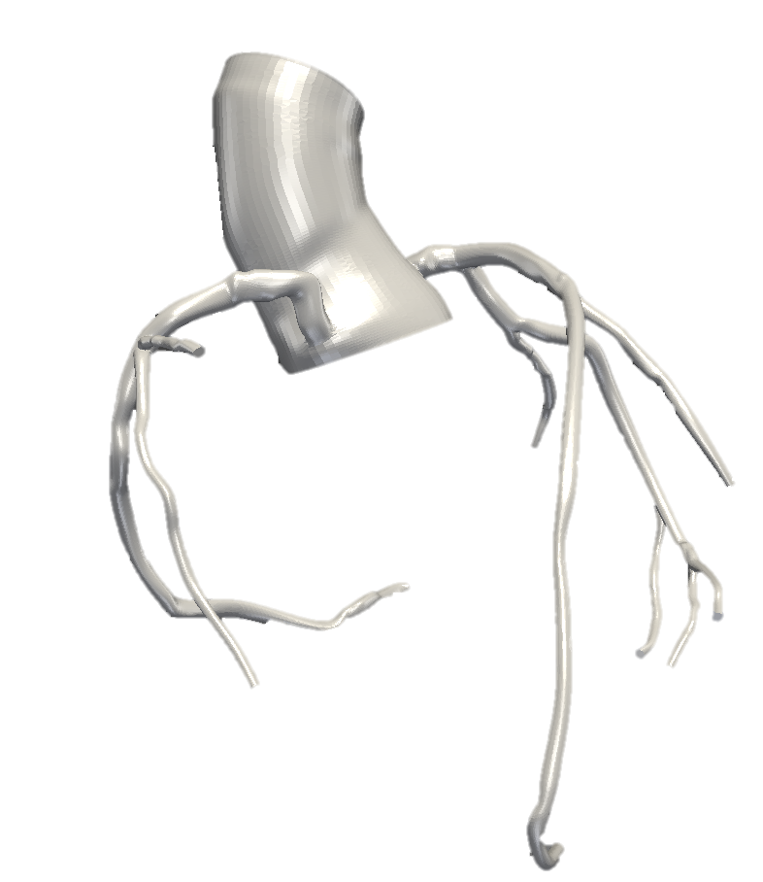
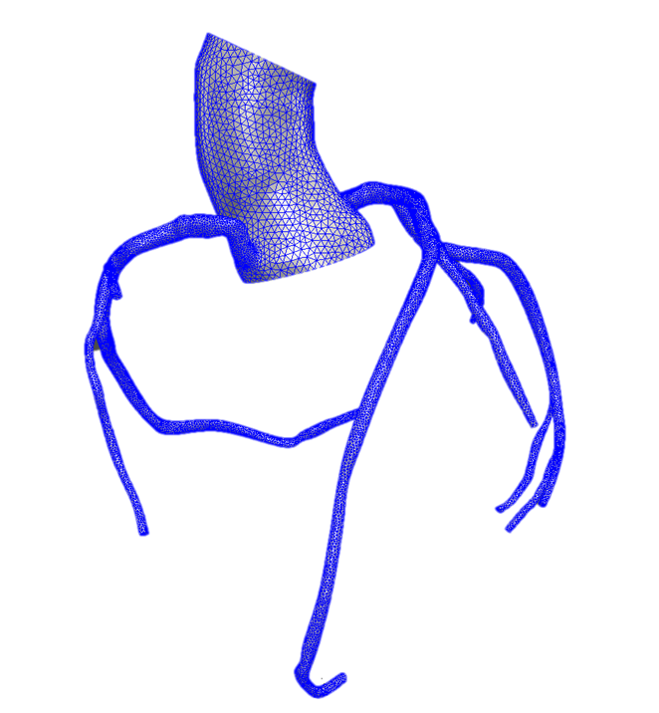
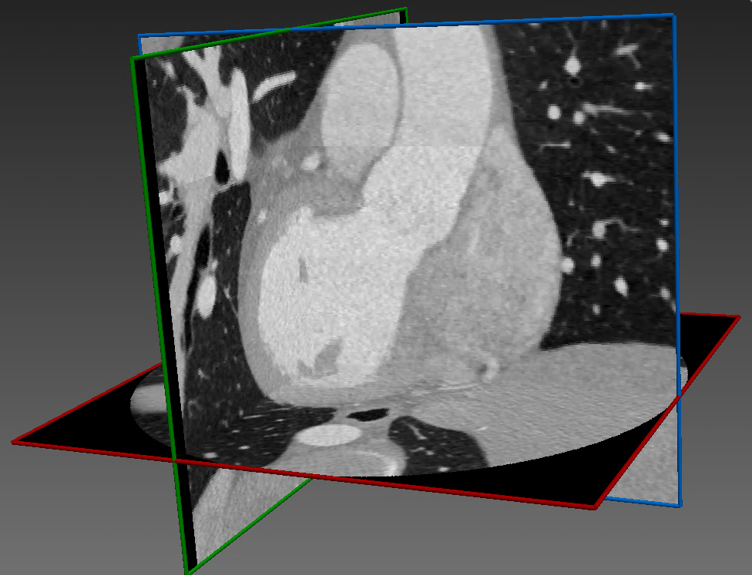
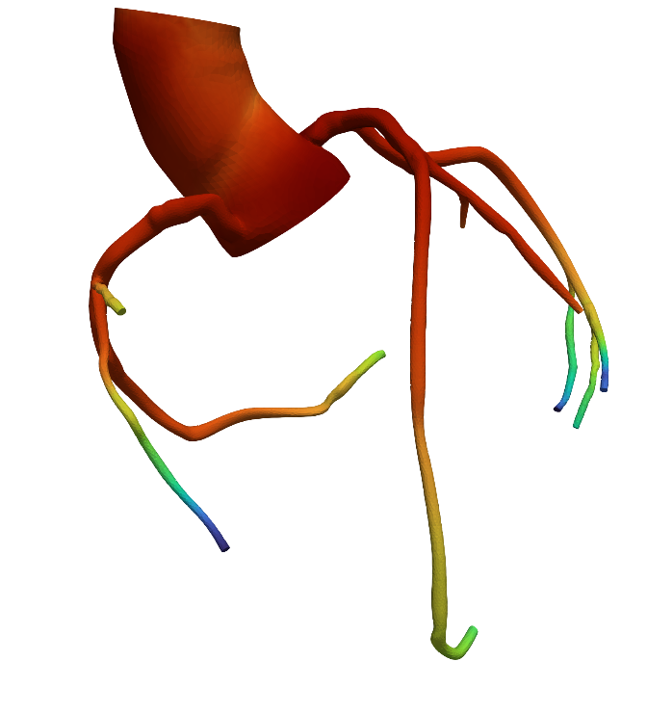
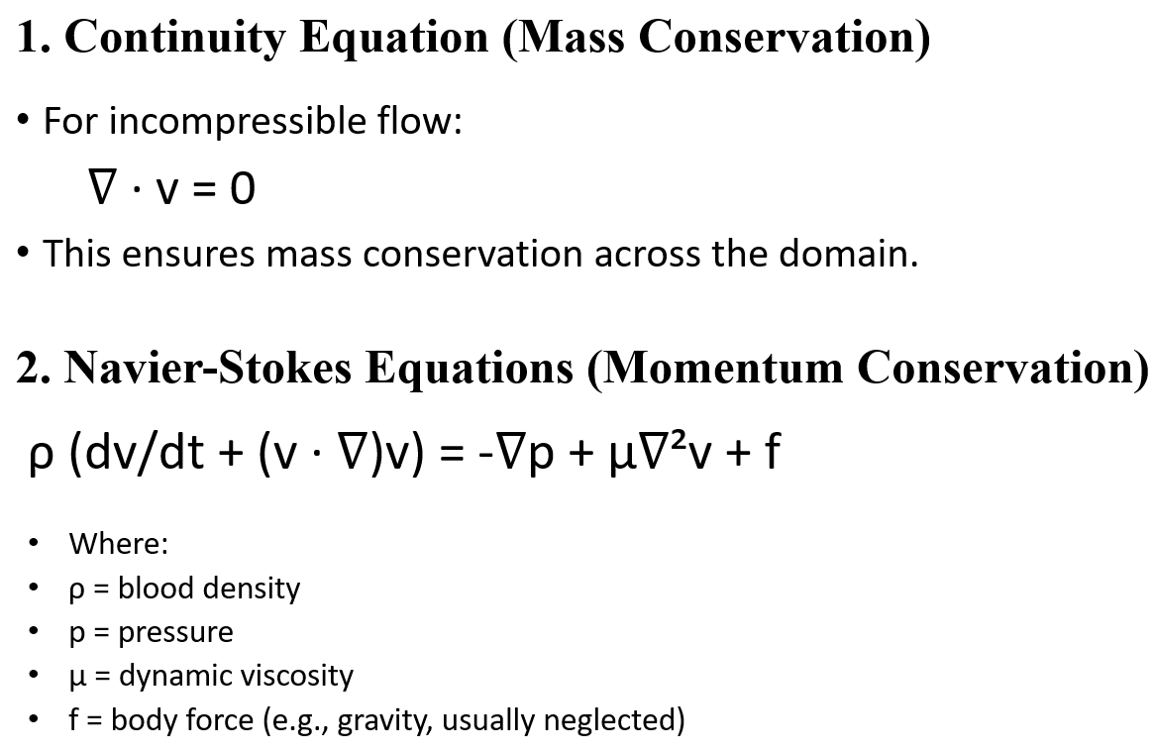
WORK FLOW :
Creating the Paths and Segmentations of the Coronary Arterial Tree.
Reconstructed Coronary Model
from ‘Sim Vascular’
Mesh model
2D Image Data - CT Scan…
Hemodynamic Flow Analysis

Slide 3
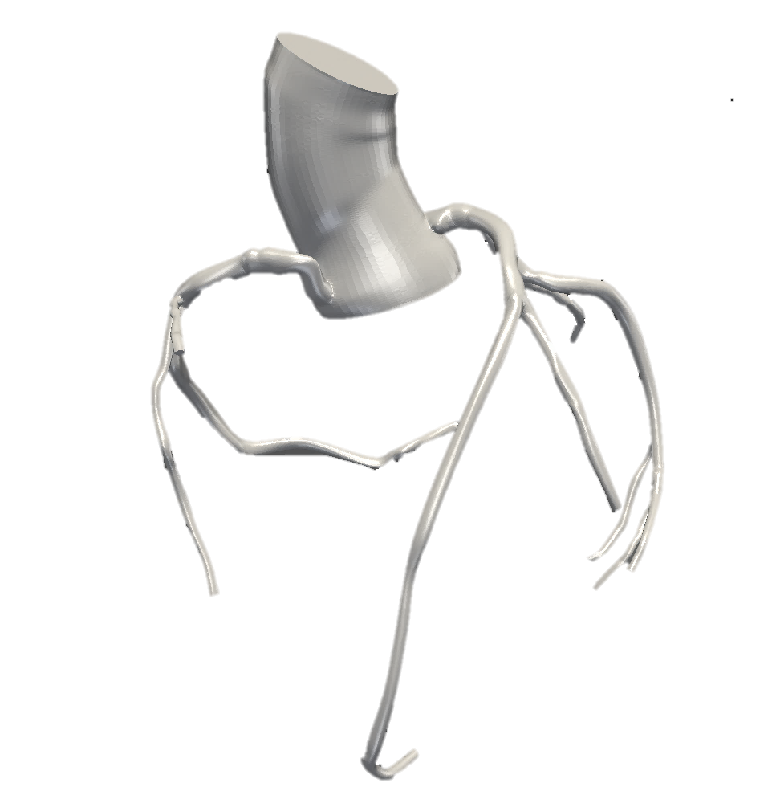

3-Dimensional Coronary Arterial Tree Model
This Coronary Arterial Tree model was extracted and the 3-D model was reconstructed by creating the paths and segmentation in a SIMVASCULAR Software (designed by Stanford University).
Simvascular is the only fully open-source software package providing a complete pipeline from medical image data segmentation to patient specific blood flow simulation and analysis.
SIMVASCULAR Software capabilities:
Model construction:
  Manual path identification and segmentation
  Automatic segmentation using ML
  Automatic surface model generation
  Meshing with advanced options (e.g., boundary layer, local refinement)
High performance finite element solver for 3D simulations of vascular hemodynamics:
  FSI (Fluid-structure interaction)
  CMM (Coupled momentum method)
  ALE (Arbitrary Lagrangian Method)
  Navier-Stokes equations with fixed arterial wall
Fig. Solid Model representation of a Human Coronary Artery Tree

Slide 4
1. Continuity Equation (Mass Conservation)
Governing Solver Equations:
For incompressible flow:
∇ · v = 0
This ensures mass conservation across the domain.
2. Navier-Stokes Equations (Momentum Conservation)
ρ (dv/dt + (v · ∇)v) = -∇p + μ∇²v + f
Where:
ρ = blood density (approx. 1060 kg/m³)
p = pressure
μ = dynamic viscosity (approx. 0.0035 Pa·s)
f = body force (e.g., gravity, usually neglected)

Slide 5
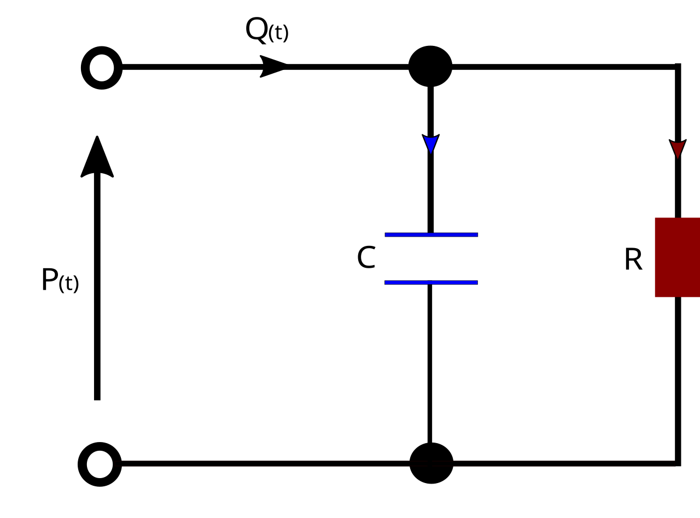
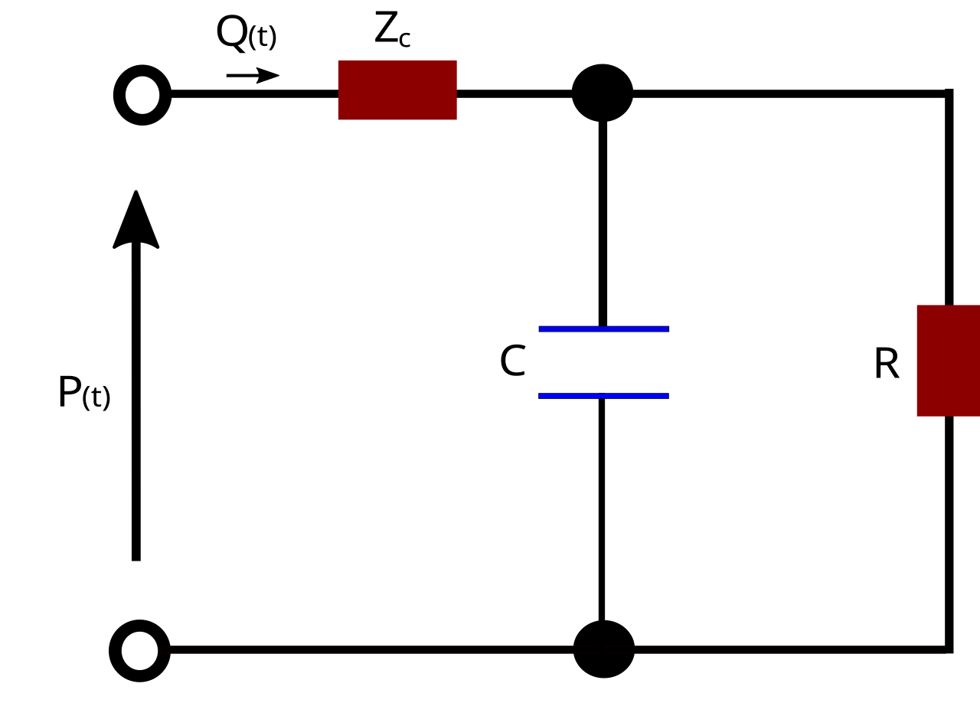
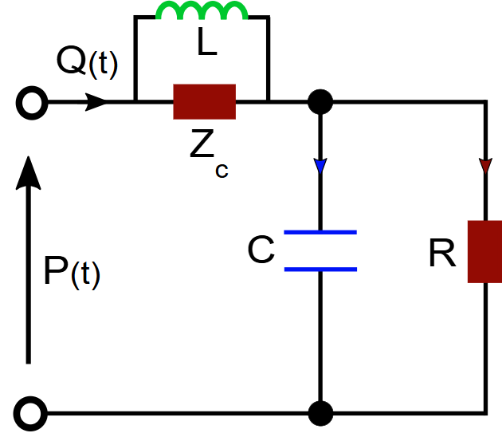
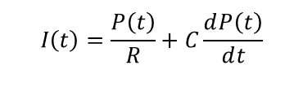

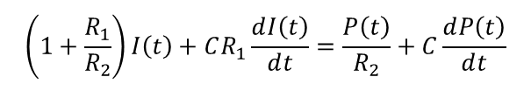
Different types of Windkessel Model:
2-Element Windkessel Model:
Frank's original two-element model comprised:
Compliance (C): representing the elastic storage capacity of large arteries, and
Resistance (R): accounting for peripheral vascular resistance.
Governing Equation:
were,
P(t) is the pressure,
Q(t) is flow rate,
R is the peripheral resistance,
C is the compliance and
dP(t)/dt is the time derivative of pressure.
3-Element Windkessel Model:
Westerhof et al. (1969) introduced the three-element Windkessel model. This model introduced a Characteristic Impedance (R1) component, capturing the inertial and elastic behavior of the proximal aorta and large arteries immediately downstream of the heart.
Governing Equation:
were,
P(t) is the pressure,
Q(t) is flow rate,
R1 is the Characteristic Impedance
R2 is the peripheral resistance,
C is the compliance and
dP(t)/dt is the time derivative of pressure.
4-Element Windkessel Model:
Four-element models and distributed models have also been proposed to capture viscoelastic effects (Stergiopulos et al., 1992). It is an advanced lumped-parameter model used to represent the hemodynamic behavior of the arterial system, particularly under pulsatile flow conditions. An additional element called inertance (L) is introduced, which accounts for the inertia of the moving blood mass, especially in large arteries like the aorta.
Governing Equation:
were,
P(t) is the pressure,
Q(t) is flow rate,
R1 is the Characteristic Impedance,
R2 is the peripheral resistance,
L is the inductance
C is the compliance and
dP(t)/dt is the time derivative of pressure.
I(t)
I(t)
R1
I(t)
R1
R2
R2
$$I\left(t\right)=\frac{P\left(t\right)}{R}+C\frac{ⅆP\left(t\right)}{ⅆt}$$
$$\left(1+\frac{R_{1}}{R_{2}}\right)I\left(t\right)+CR_{1}\frac{ⅆI\left(t\right)}{ⅆt}=\frac{P\left(t\right)}{R_{2}}+C\frac{ⅆP\left(t\right)}{ⅆt}$$
$$\left(1+\frac{R_{1}}{R_{2}}\right)I\left(t\right)+\left(R_{1}C+\frac{L}{R_{2}}\right)\frac{ⅆI\left(t\right)}{R_{2}}+LC\frac{ⅆ^{2}I\left(t\right)}{ⅆt^{2}}=\frac{P\left(t\right)}{R_{2}}+C\frac{ⅆP\left(t\right)}{ⅆt}$$

Slide 6
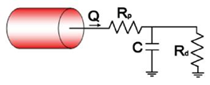
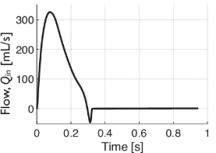
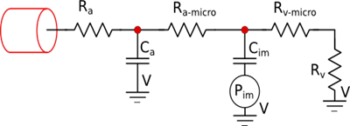
Implementing the Windkessel boundary conditions in 3-D Human Coronary Arterial Tree:
BC conditions for Aortic Outlet ‘2’
2
Inlet Flow (1):
1
11
3
5
7
BC conditions from Outlets ‘3’ to ‘11’
8
10
9
4
6

Slide 7
Results and Analysis
0-Dimensional Windkessel Models behaviour estimated was using MATLAB software.
  In this all the 3 element Windkessel Models were simulated and results were captured.
  Performed an uncertainty analysis in the 0-D Windkessel Model using Monte-Carlo Simulation.
  Also performed a Sensitivity/Variation Analysis by changing the parameters value by certain percentages.
3-Dimensional Patient Specific Coronary Arterial tree hemodynamics was studied using SIMVASCULAR software.
  With the help of the software, performed a simulation with realistic boundary conditions.
  Used ‘svSolver’ a component of the Simvascular software which performed various equations like Navier-Stokes Equations etc.
  Used ‘Paraview’ software, for post-processing to view the average pressure, velocity analysis, average speed of blood flow and Wall shear stress.

Slide 8
0-Dimensional Windkessel Models behaviour estimated using MATLAB
Different parameter values were considered to check the model behaviour and the results were estimated.
The values of normal parameters of the Windkessel models of a Human Coronary Artery Tree
Parameters | R2 [mmHg.s/ml] | C [ml/mmHg] | R1 [mmHg.s/ml] | L [mmHg.s2/ml]
2 Element | 0.9 | 1.0666 | _ | _
 | 0.6632 | 1.7389 | _ | _
3 Element | 0.9 | 1.0666 | 0.04 | _
 | 0.6632 | 1.7389 | 0.0409 | _
4 Element | 0.9 | 1.0666 | 0.04 | 0.2
 | 0.6632 | 1.7389 | 0.0409 | 0.3

Slide 9
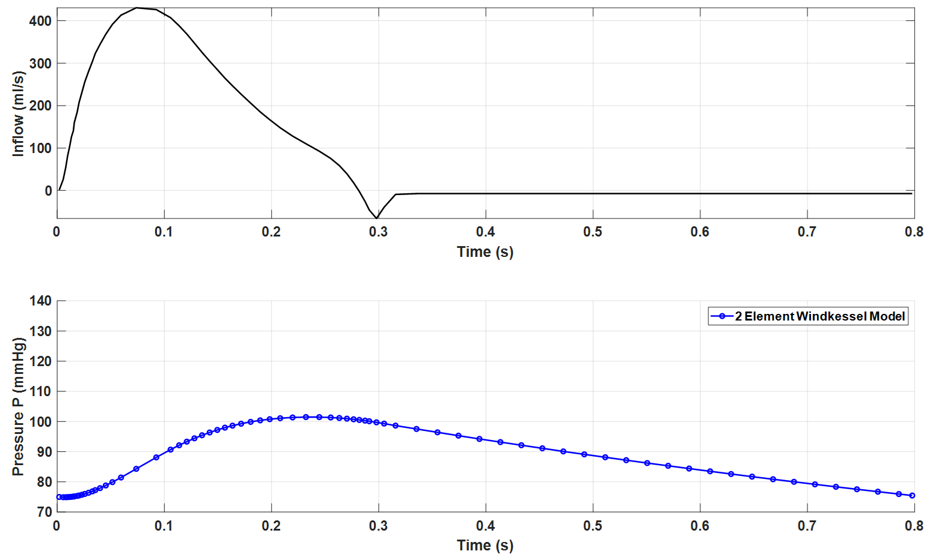
Windkessel Model behaviour against the given inflow for 1 Cardiac Cycle :
Aortic Input Flow

Slide 10
Windkessel Model behaviour against the given inflow for 4 Cardiac Cycle :
Aortic Input Flow

Slide 11
A comparative plot of 2 element, 3 element and 4 element Windkessel equation plotted against Aortic inflow function:
Parameter used:
Parameter | Symbol | Value | Unit
Peripheral Resistance | R2 | 0.6632 | mmHg·s/mL
Compliance | C | 1.7389 | mL/mmHg
Impedance | R1 | 0.04 | mmHg·s/mL
Outflow Pressure | Pout | 32 | mmHg

Slide 12
Uncertainty Analysis in 0-D Windkessel Model using Monte Carlo Simulation :
Methodology of Monte-Carlo Simulation:
Model Setup: The 3-element Windkessel model represents the arterial system by three components: a proximal resistance (R₁), compliance (C), and distal resistance (R₂). The governing differential equation is solved using a numerical ODE solver, incorporating actual measured input flow data provided via a table file.
Input Flow Data: Flow waveform data (Inflow) is imported. Interpolation techniques are applied to match flow data with the solver time points for continuous simulation.
Uncertain Parameters: R₁, C, and R₂ are treated as uncertain parameters. Nominal (mean) values are assigned, and uncertainties are introduced using a normal distribution with specified standard deviations i.e. 0%, 3%, 6% and 12%.
Monte Carlo Simulation: A large number (e.g., 1000 or more) of random samples of R₁, C, and R₂ are generated based on their assumed distributions. For each set of sampled parameters, the 3WK model is simulated to predict the pressure waveform.
Post-Processing: For each time point, the mean, standard deviation, and confidence intervals (e.g., 95%) of the simulated pressure are calculated across all MC samples. The simulation results are compared against nominal (unperturbed) solutions.
The main goal of this work is that the:
The uncertainty in model parameters leads to a range (band) of possible pressure predictions. As the parameter uncertainty (standard deviation) increases, the width of the pressure prediction band also increases. Monte Carlo results highlight the model's sensitivity to R₁, C, and R₂ and help identify parameters to prioritize in future calibrations or measurements.

Slide 13
Uncertainty Quantification of Pressure Waveform - 3-Element Windkessel Model:

Slide 14
Parameter Sensitivity Analysis:
The value of R1 and R2 were changed by adding certain percentages.
1%, 2%, 4%, 6% and 12% were the added with the original values of R1 and R2 and the changes in the pressure waveforms were recorded.
When we changed the value of R1, the value of R2 and C was kept constant.
When we changed the value of R2, the value of R1 and C was kept constant.
When we changed the value of C, the value of R1 and R2 was kept constant.

Slide 15
Parameter Sensitivity by changing the values of R1 with certain percentage (keeping R2,C constant):

Slide 16
Pressure Difference Bar Plot:
Pressure Change Summary for R1:
R1 Change | Max ΔP | Min ΔP | Mean ΔP
+1.0% | 0.171 | -0.056 | 0.036
+2.0% | 0.342 | -0.112 | 0.073
+4.0% | 0.684 | -0.224 | 0.146
+6.0% | 1.026 | -0.336 | 0.219
+12.0% | 2.052 | -0.673 | 0.438

Slide 17
Parameter Sensitivity by changing the values of R2 with certain percentage (keeping R1,C constant):

Slide 18
Pressure Difference Bar Plot for R2 variation:
Pressure Change Summary for R2:
R2 Change | Max ΔP | Min ΔP | Mean ΔP
+1.0% | 0.276 | 0.000 | 0.117
+2.0% | 0.548 | 0.000 | 0.233
+4.0% | 1.081 | 0.000 | 0.459
+6.0% | 1.600 | 0.000 | 0.677
+12.0% | 3.079 | 0.000 | 1.292

Slide 19
Parameter Sensitivity by changing the values of C with certain percentage (keeping R1,R2 constant):

Slide 20
Pressure Difference Bar Plot for C variation:
Pressure Change Summary for C:
C Change | Max ΔP | Min ΔP | Mean ΔP
+1.0% | 0.061 | -0.259 | -0.101
+2.0% | 0.369 | -0.516 | -0.117
+4.0% | 0.355 | -0.994 | -0.369
+6.0% | 0.406 | -1.417 | -0.552
+12.0% | 2.368 | -2.464 | -0.105

Slide 21
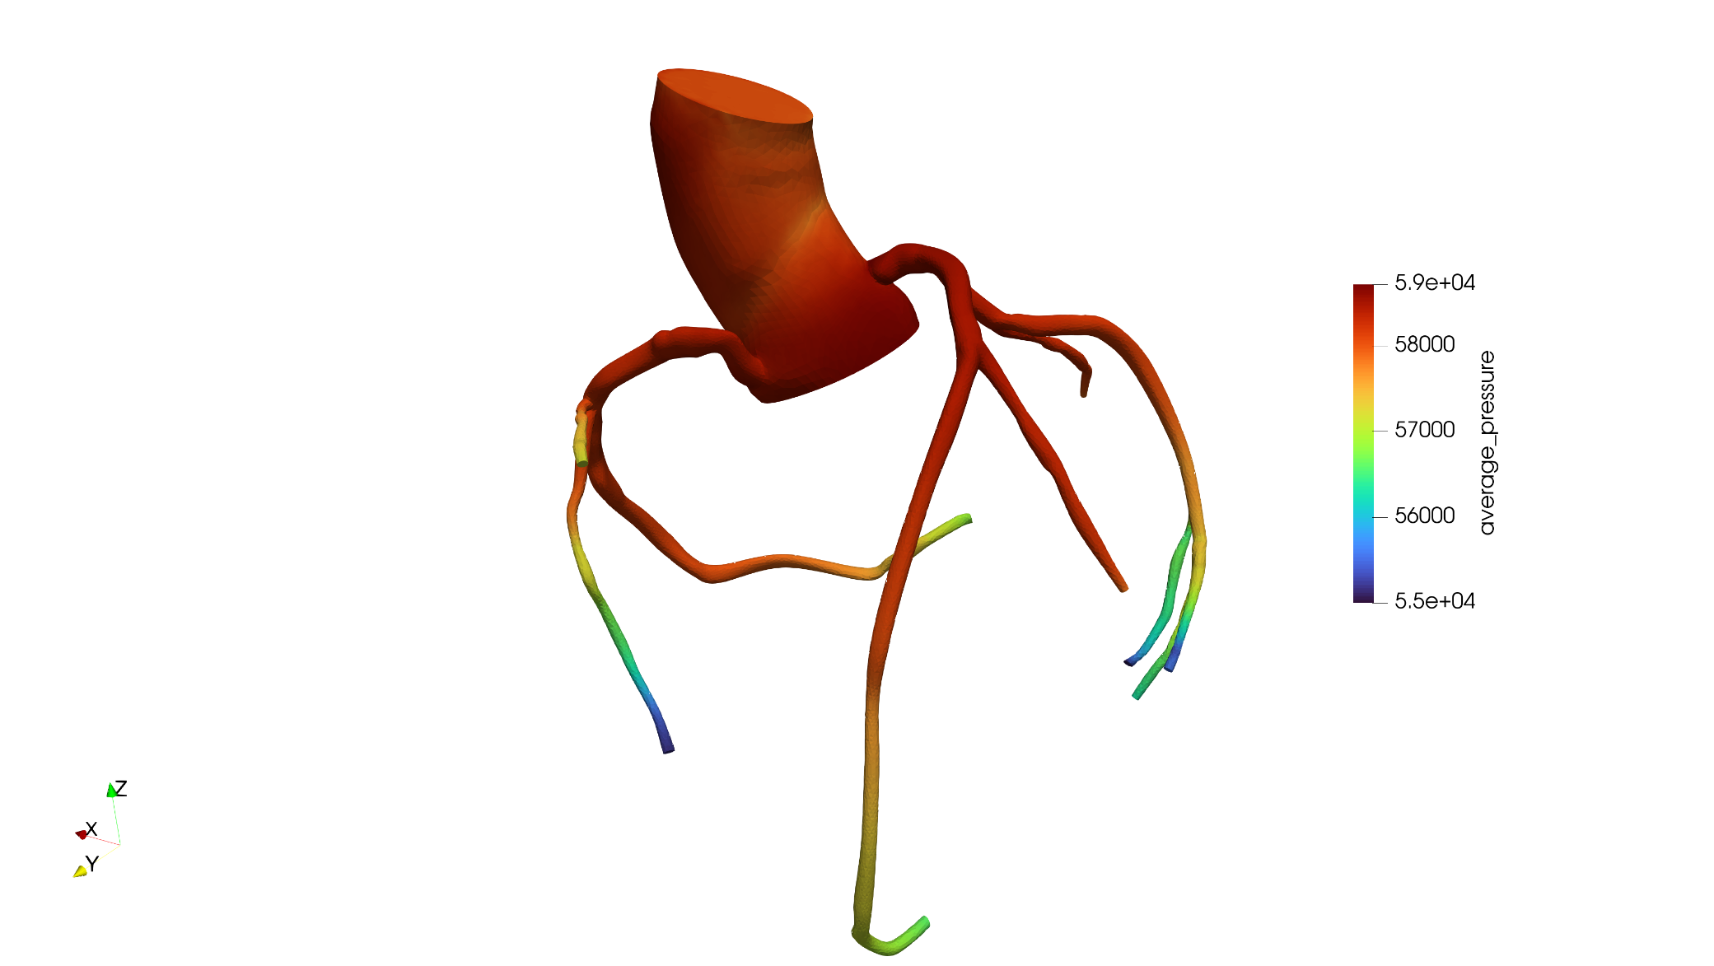
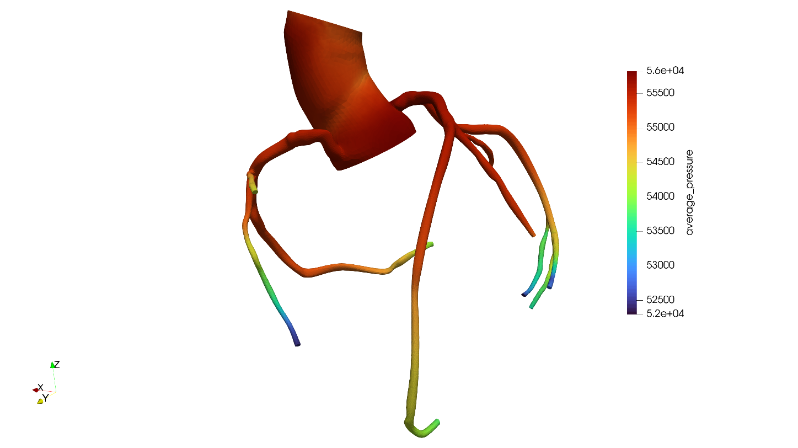
3-Dimensional Patient Specific Coronary Arterial tree hemodynamics was studied using SIMVASCULAR software
Average Pressure Analysis:
Average Pressure Analysis at normal inflow
Average Pressure Analysis at 5% change in Inflow file

Slide 22
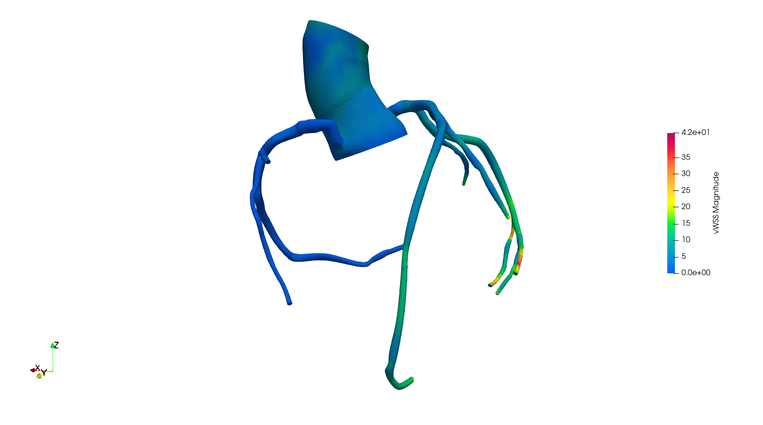
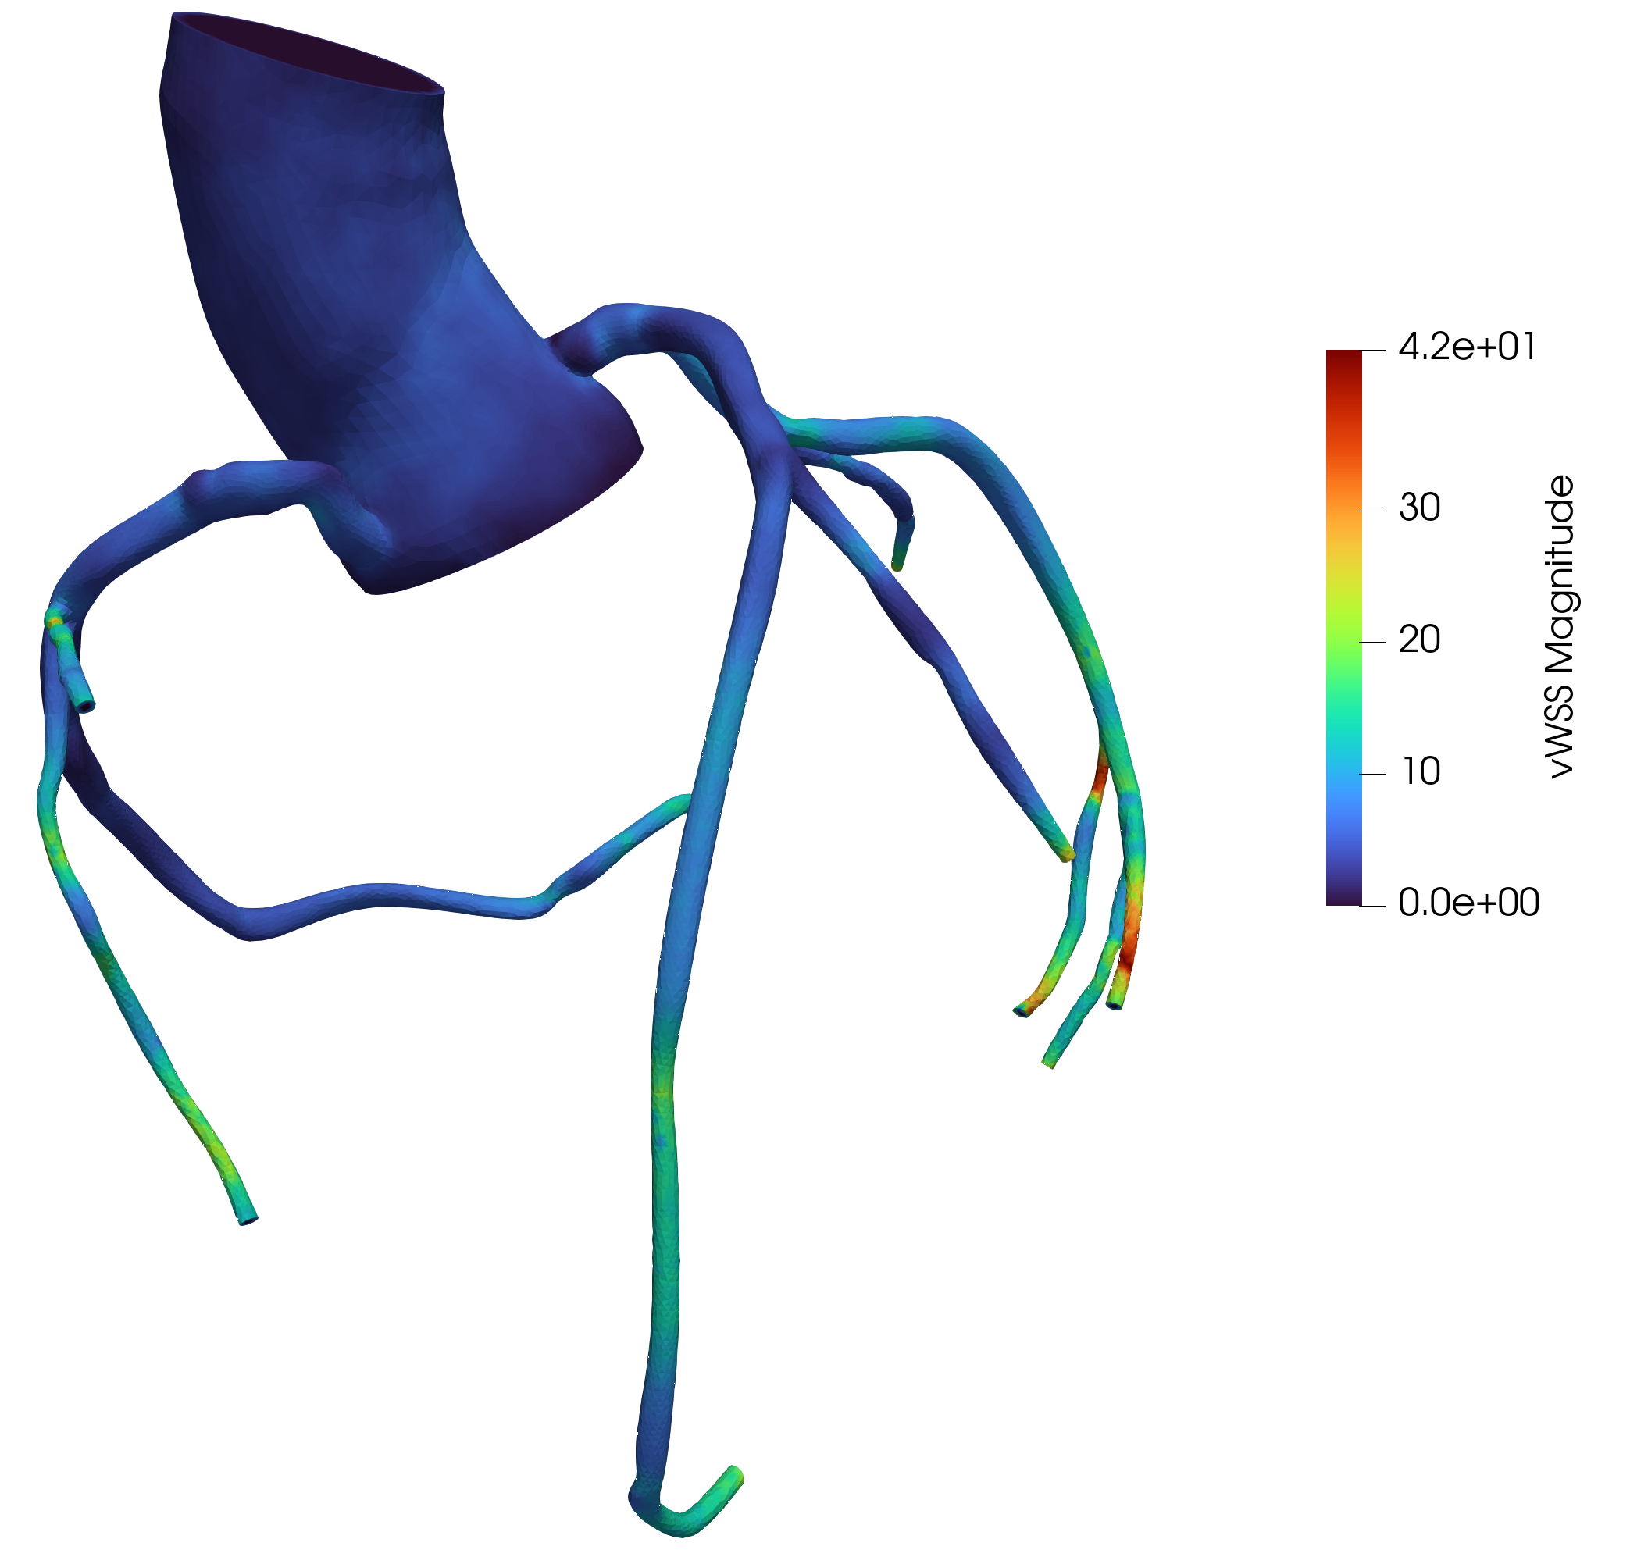
Wall Shear Stress Analysis:
Wall Shear Stress Analysis at normal inflow
Wall Shear Stress Analysis at 5% change in Inflow file

Slide 23
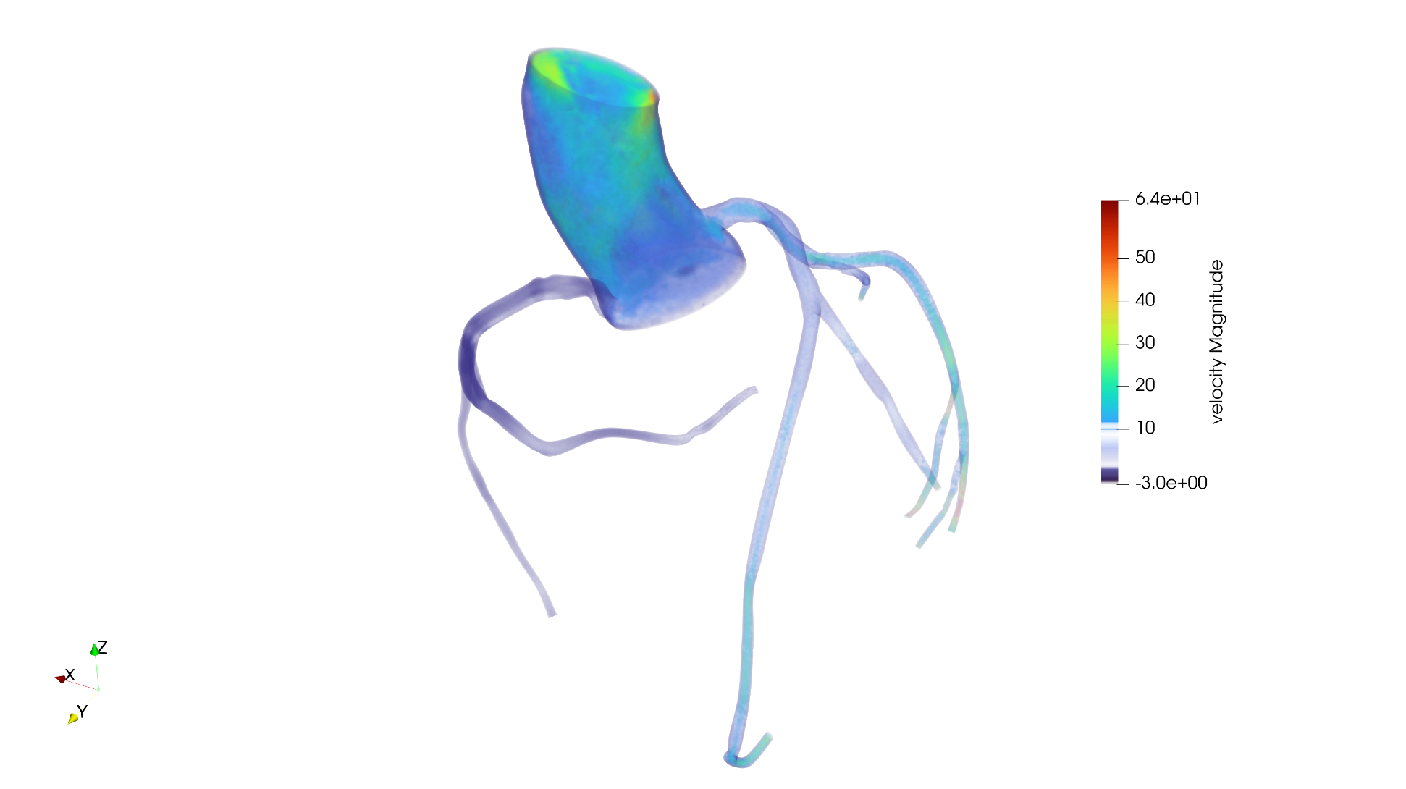
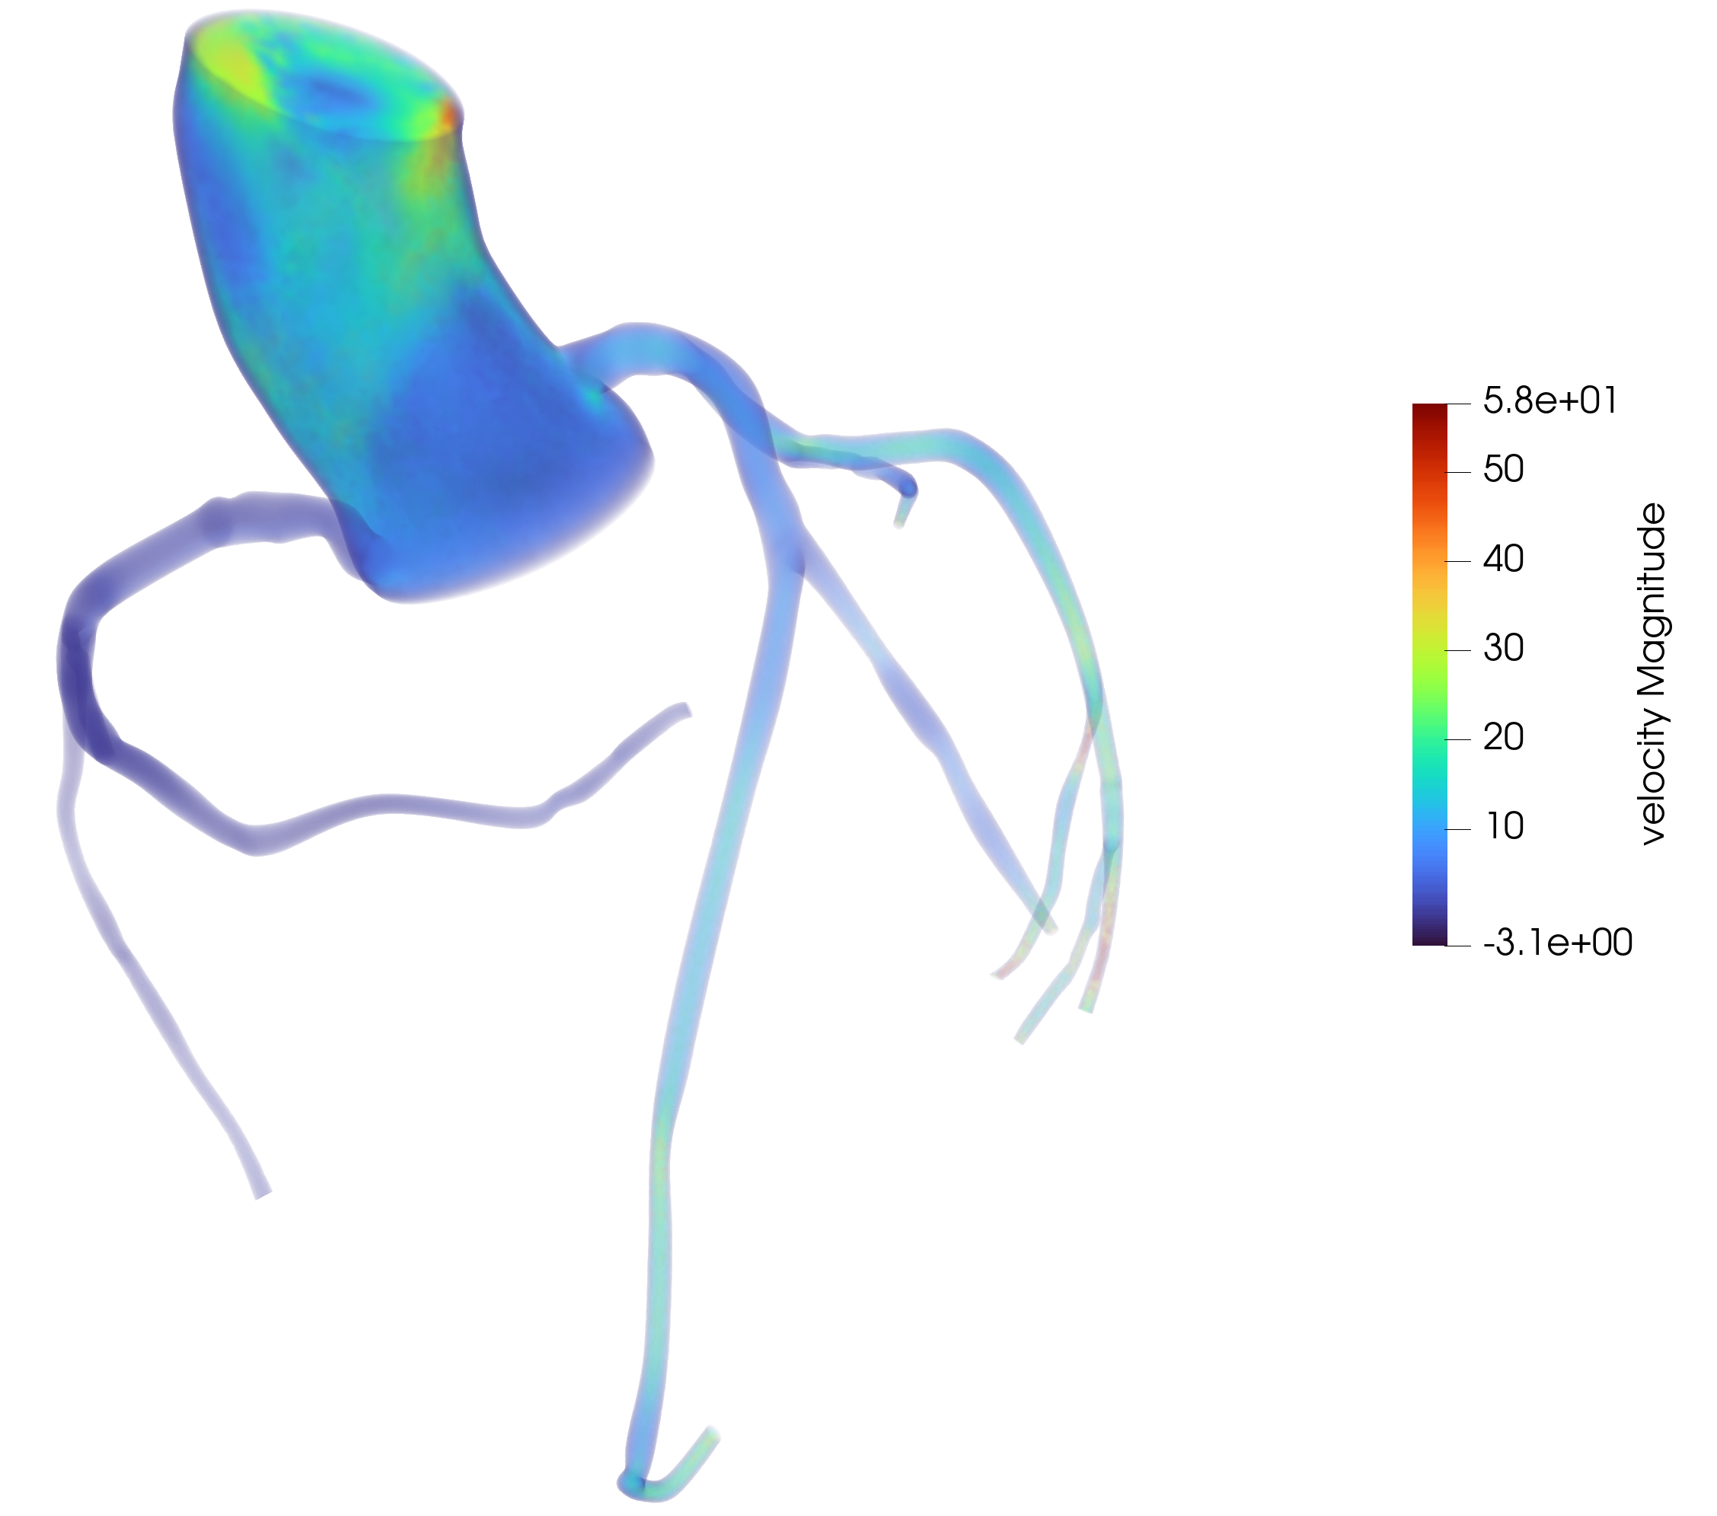
Flow Velocity Analysis: At peak of Systole
Velocity Analysis at normal inflow
Velocity Analysis at 5% change in Inflow file

Slide 24
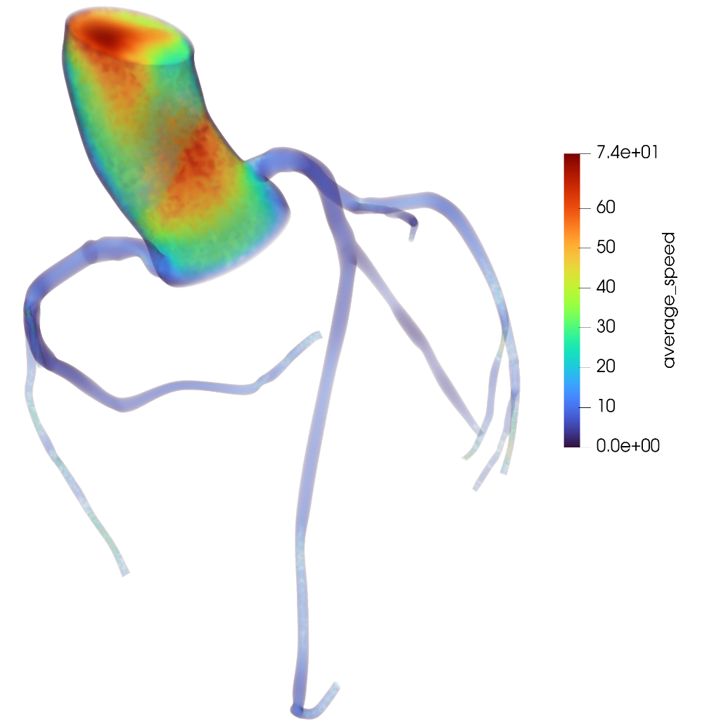
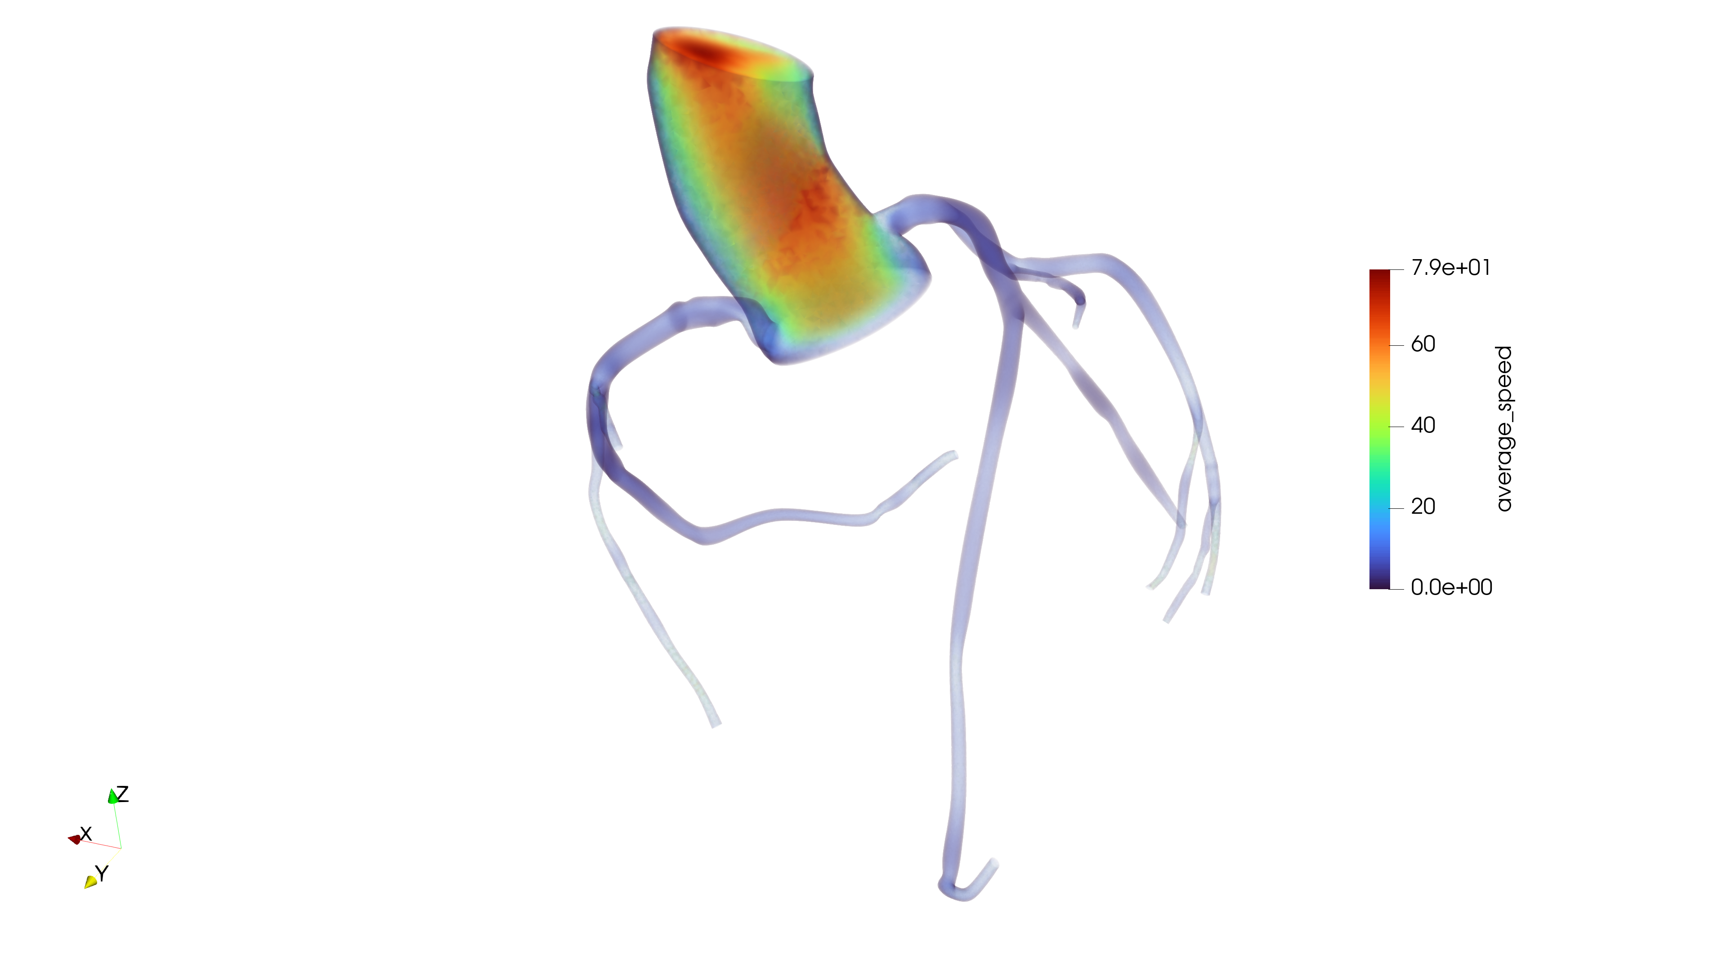
Average Speed of blood flow Analysis:
Average speed analysis at normal inflow
Average speed analysis at 5% change in Inflow file

Slide 25
Pressure Plots with normal Inflow file:

Slide 28
Pressure Plotted by increasing the values in the Inflow file by “5%”:

Slide 31
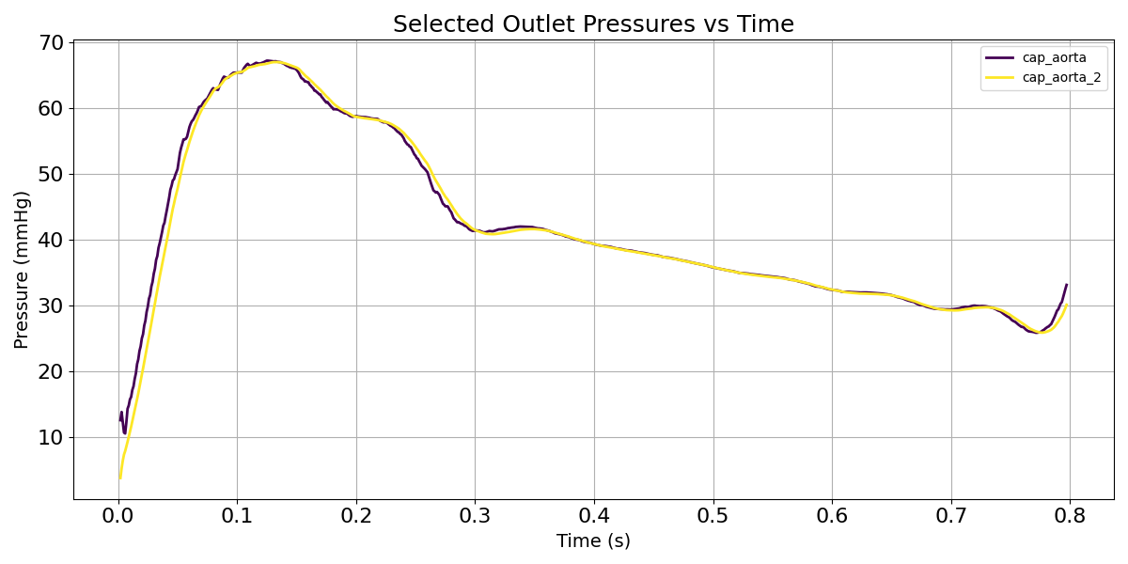
Pressure Comparison of 0-Dimensinal and 3-Dimnesional Windkessel Model in Coronary Hemodynamics
Feature | 0-D Windkessel Model (MATLAB) | 3-D Windkessel Model (CFD)
Visual Characteristics | Smooth, idealized waveform | More detailed, physiologically accurate
Peak Pressure | ~95 mmHg | ~67 mmHg
Initial Systolic Rise | Steep and smooth | Slightly delayed due to spatial effects
Dicrotic Notch / Reflections | Small dip at ~0.3 s, but simple | Multiple subtle wave reflections post-systole
Diastolic Decay | Exponential, clean slope | More gradual with micro fluctuations
Noise or Ripple | Very little | Some fluctuation from flow interactions
Realism | Good approximation | More anatomically accurate
Conclusion:
The 3-D Windkessel model is superior in accuracy and physiological detail, capturing complex coronary flow and pressure behavior.
The 0-D Windkessel model is useful for reduced-order analysis but tends to oversimplify, especially in dynamic coronary systems and help in sighting dichotic notch.
If the goal is clinical insight or precision modeling, the 3-D approach is preferred. For parameter studies or large-scale simulations, 0-D models are efficient and interpretable.

Slide 32
Conclusion and Future Works
This project successfully developed a patient-specific coronary artery model by integrating anatomical reconstruction, CFD, and physiologically realistic boundary conditions. Accurate geometry from medical imaging ensured anatomical fidelity, while CFD enabled detailed analysis of wall shear stress, pressure, and flow velocity. The inclusion of the Windkessel model improved physiological relevance by simulating downstream vascular behavior under pulsatile flow. Validation against clinical data and sensitivity analysis confirmed model accuracy and emphasized the importance of parameter tuning. Among the tested models, the 3-element Windkessel model showed superior performance in replicating arterial pressure waveforms. Overall, this work provides a robust framework for simulating coronary hemodynamics and supports future personalized diagnosis and treatment planning in cardiovascular disease.
Future work may include:
  Integration of vessel wall mechanics (fluid–structure interaction).
  AI-driven parameter estimation for enhanced personalization.
  Real-time or accelerated simulation tools for clinical use.

Slide 33
References:
Joaquín Flores-Geronimo, Alireza Keramat, Jordi Alastruey, Yuanting Zhang, ‘Uncertainty quantification of the pressure waveform using a Windkessel model’.
Daniel R. Kerner, “Solving Windkessel Models with MLAB”.
S. Sankaran, M. Esmaily Moghadam, A.M. Kahn, J. Guccione, E. Tseng and A.L. Marsden, Patient-specific multiscale modeling of blood flow for coronary artery bypass graft surgery.
Y. Zhou, G.S. Kassab, and S. Molloi. On the design of the coronary arterial tree: a generalization of Murray’s law.
J.S. Tran, D.E. Schiavazzi, A.B. Ramachandra, A.M. Kahn, and A.L. Marsden, Automated Tuning for Parameter Identification and Uncertainty Quantification in Multi-scale Coronary Simulations.
Kim HJ, Vignon-Clementel IE, Coogan JS, Figueroa CA, Jansen KE, Taylor CA. Patient-specific modeling of blood flow and pressure in human coronary arteries.
Kit Mills Bransby, Vincenzo Tufaro, Murat Cap, Greg Slabaugh, Christos Bourantas, Qianni Zhang. 3D Coronary Vessel Reconstruction from Bi-Plane Angiography using Graph Convolutional Networks.
Antonuccio MN, Mariotti A, Fanni BM, Capellini K, Capelli C, Sauvage E, Celi S. Effects of Uncertainty of Outlet Boundary Conditions in a Patient-Specific Case of Aortic Coarctation.
Zhong L, Zhang JM, Su B, Tan RS, Allen JC, Kassab GS. Application of Patient-Specific Computational Fluid Dynamics in Coronary and Intra-Cardiac Flow Simulations: Challenges and Opportunities

